Slide 1
Summary of Existing Conditions
SSM Transit routes are designed to maximize coverage and converge at the Dennis Street terminal
Routes can be circuitous, resulting in indirect travel outside of the core
On-time performance issues are noted on several routes
30-minute systemwide daytime service (60-minute evening and weekend service) everywhere, regardless of demand
Service gap noted at 6 p.m. with switch to evening schedule
Weekend evening on-demand service is misaligned with customer needs

Slide 2
What We Heard:
Rider and Community Survey

Slide 3
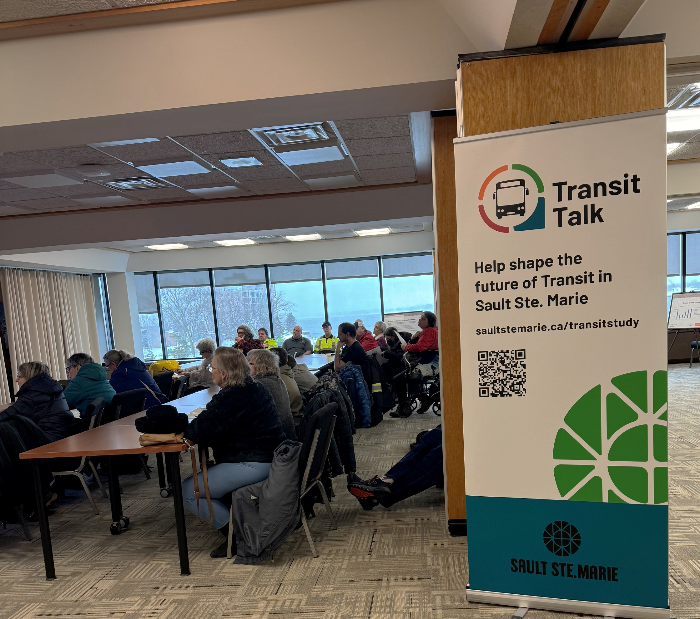
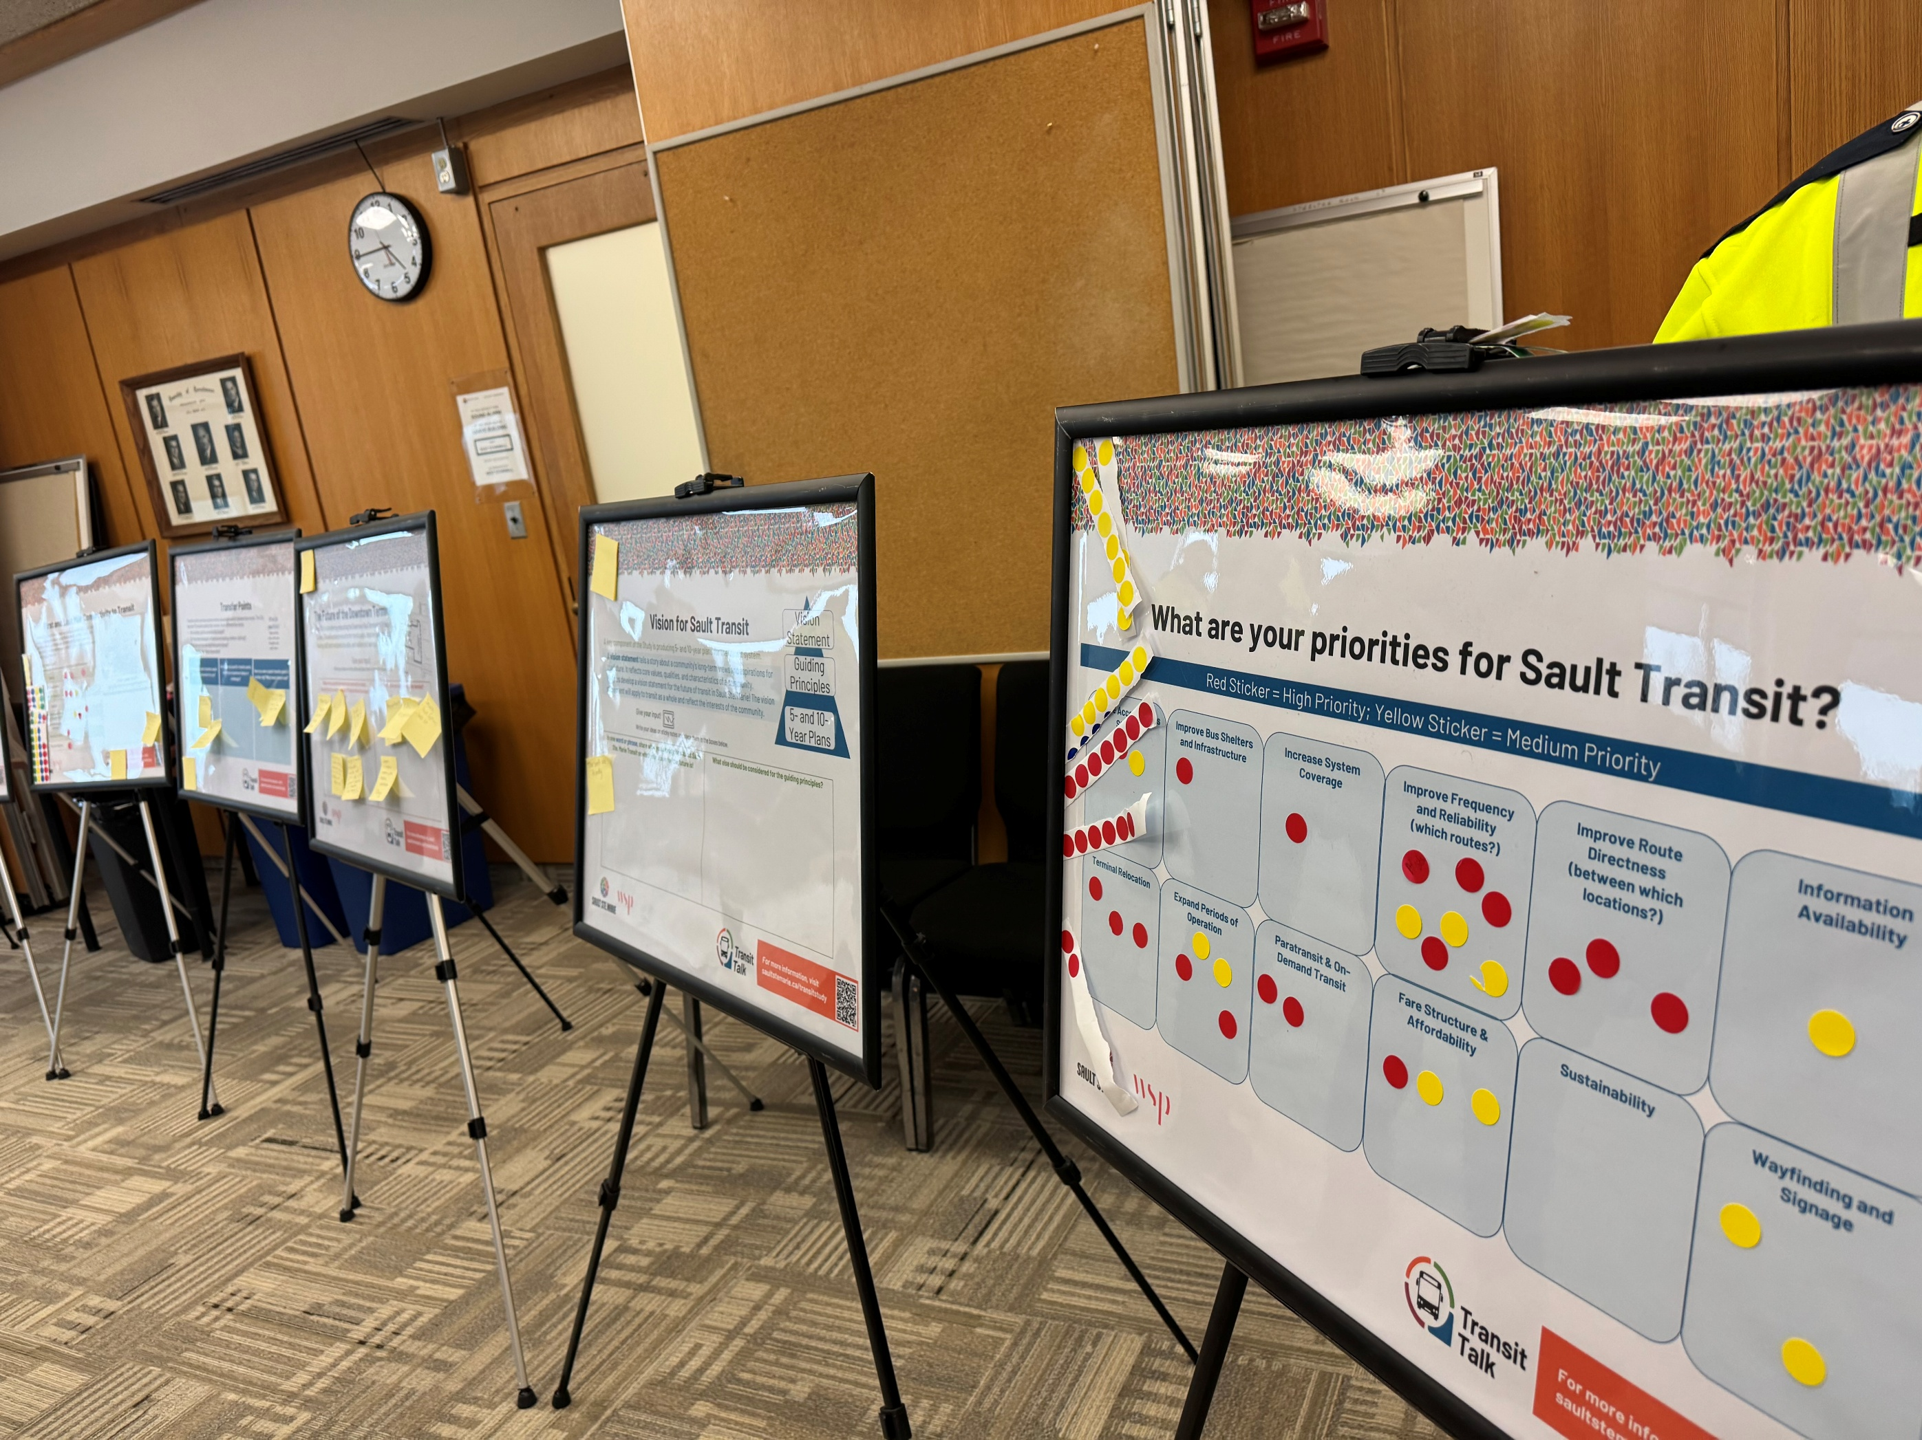
What We Heard:
Public Information Centre #1
Held at City Hall on March 25, 2025
General feedback:
Transit should not only be a means for point-to-point transportation but should support an equitable, affordable, and sustainable community.
The City should provide easy, accessible, and affordable public transit that allows citizens to choose to take transit and rely less on private vehicles.
Key Priorities:
Improve frequency and reliability
Improve route directness
Improve paratransit and alter OnDemand transit
Expand periods of operations

Slide 4
Draft Transit System Vision and Guiding Principles
DRAFT Vision Statement
Sault Transit will retain its share of the travel market by providing a local public transportation system supported by residents, academic institutions, and the business community.
Guiding Principles
Service Objectives
Provide relatively direct service between primary origins and destinations​
Provide reliable, predictable, on-time, and easy-to-comprehend all-day service for the community ​
Provide vital connectivity and improve the quality of life of residents who do not have access to an automobile.​
Provide a safe, dignified, fully-accessible service with barrier-free access to bus stops ​
Meet the travel demand generated by various target markets in the employment, academic, commercial, medical, and service industries.
Service Area Objective: Sault Transit should provide service within the urbanized area of Sault Ste. Marie.
Periods of Operation Objective: The minimum frequency of service and service hours to be provided shall be adequate to meet the various target markets within the community, including work shifts that begin at 7:00 a.m. and end at 11:00 p.m.
Connectivity Objective: Key destinations should be interconnected with relatively direct and frequent service, if possible, through multiple paths, to expand rider choice.
Guiding Principles
Provide relatively direct service between primary origins and destinations
Provide reliable, predictable, on-time, and easy-to- comprehend all-day service for the community
Provide vital connectivity and improve the quality of
life of residents who do not have access to an automobile.
Provide a safe, dignified, fully-accessible service with barrier-free access to bus stops
Meet the travel demand generated by various target
markets in the employment, academic, commercial, medical, and service industries.

Slide 5
Potential Big Moves
1. Route Realignment
Small Modifications: Route Redesign:
Option 1
Option 2
Option 3
Do minimal
Sault Loops
Sault Spine
Redesign the system based on two-way loops
Maintain current servicing parameters
Redesign the system around a central transit spine
Requires increased investment to maintain coverage
Minor Adjustments Only
Maintain current
system integrity & servicing
Patch the 6 p.m. service gap
Eliminate weekend evening on-demand service

Slide 6
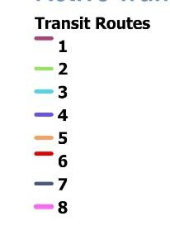
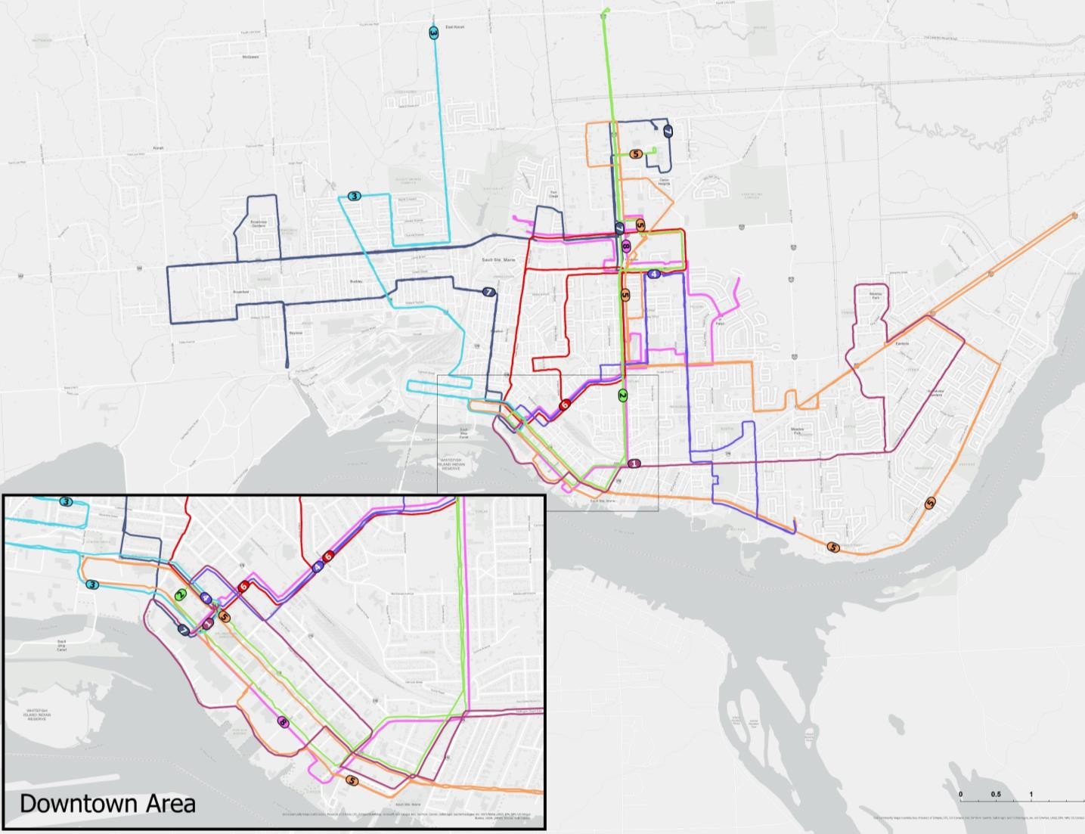
Option 1: Minimal Changes
Remove underused sections on some longer routes
Shorten routes to improve reliability and timing
Minor changes to Routes 3, 5, and 7
Impact: Slight reduction in coverage but small improvements in reliability and efficiency.

Slide 7


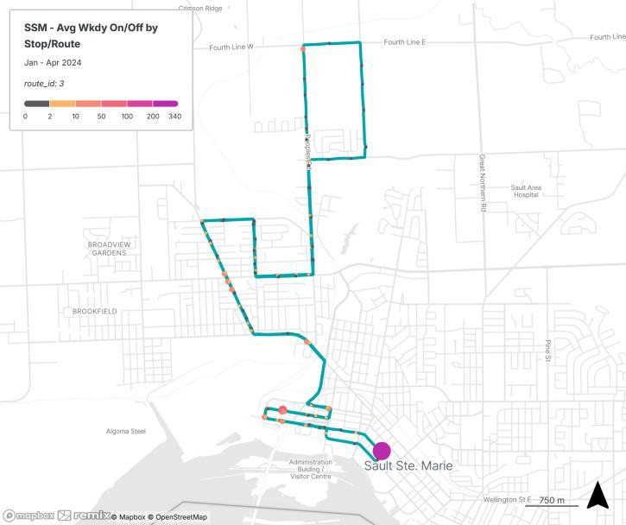
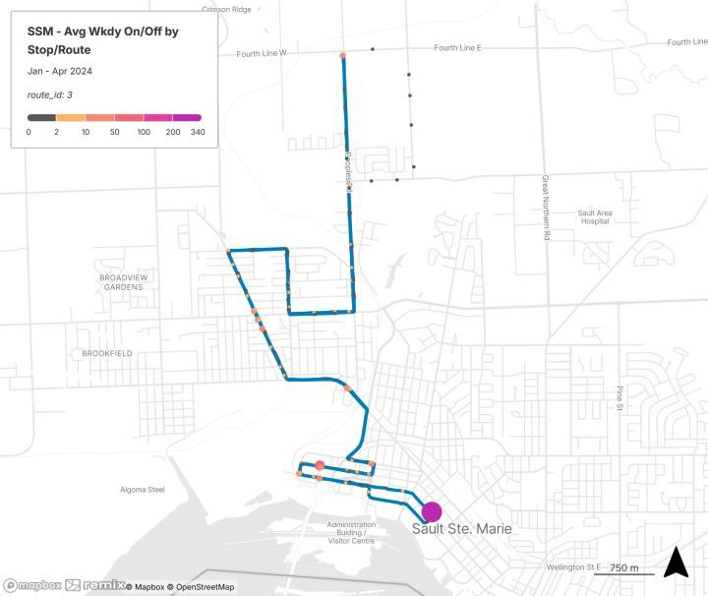
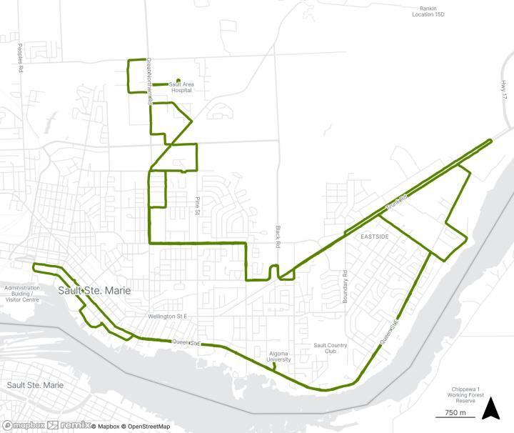
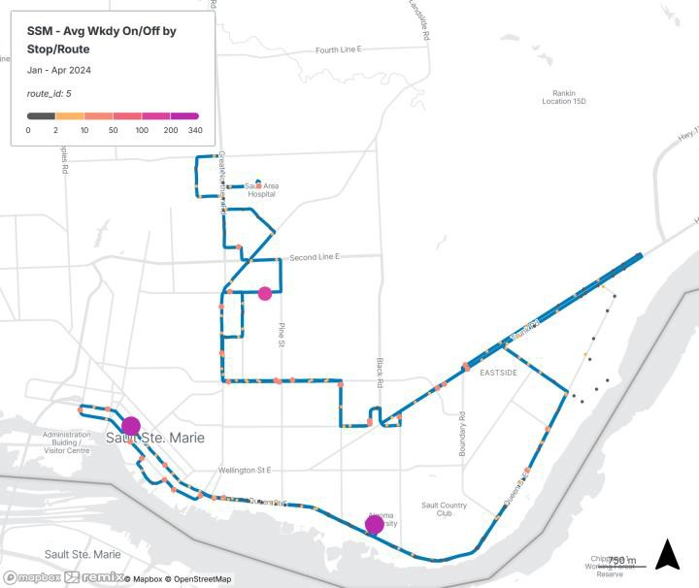
Existing
Proposed
Option 1 Route
Realignment: 3 – Korah Road
5.8 (0.75%) daily boardings would be affected
Option 1 Route
Realignment: 5 – Riverside McNabb
12 (0.6%) daily boardings would be affected

Slide 8


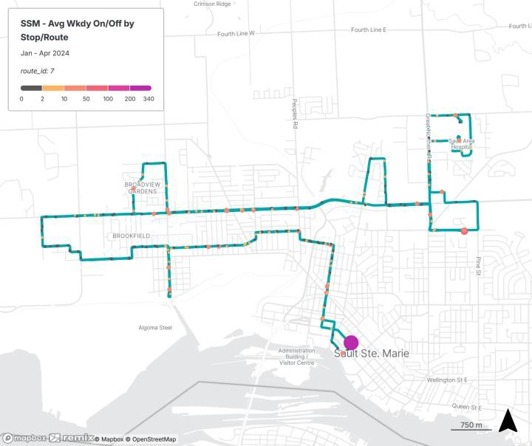
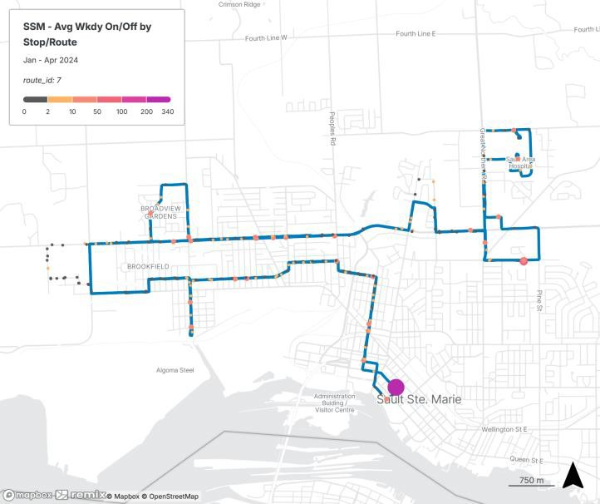
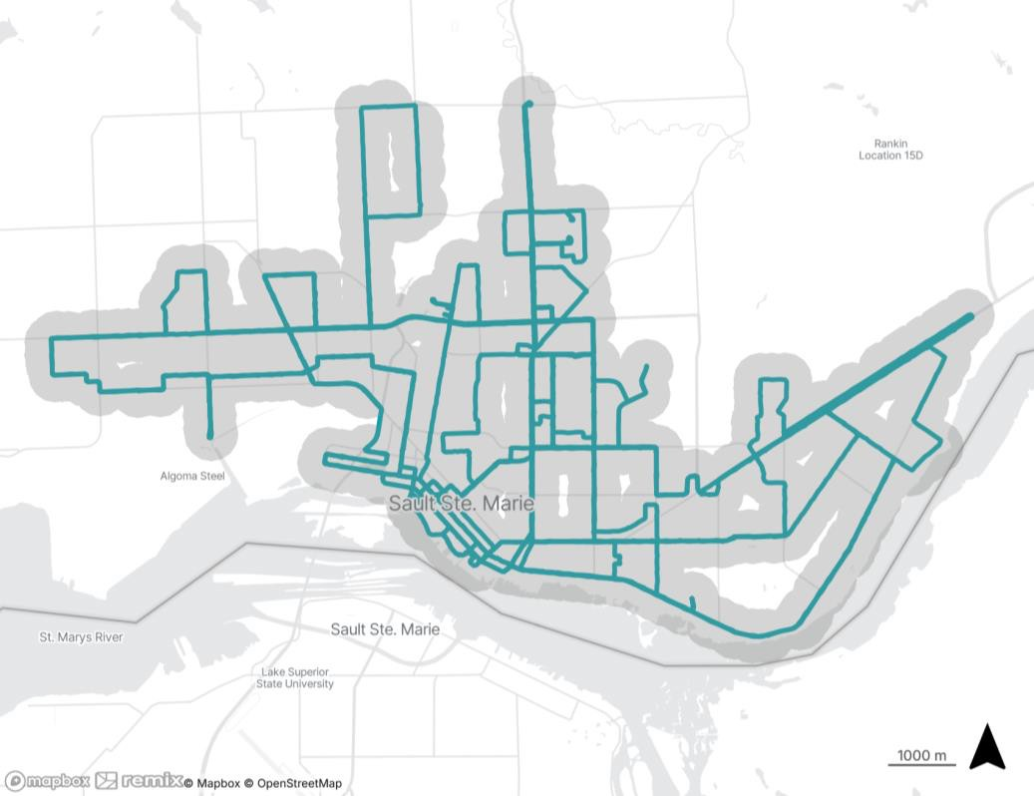
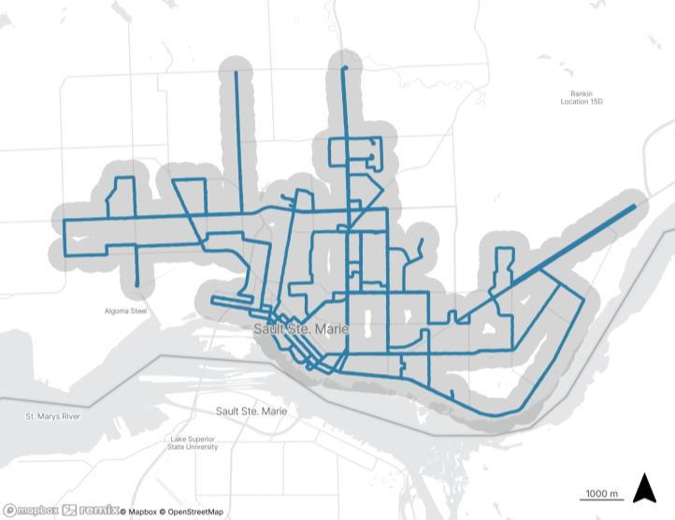
Existing
Proposed
Option 1 Route
Realignment: 7 – Steelton Second Line
18.3 (1.52%) daily boardings would be affected
Option 1 Route Realignment: Population/Jobs within 400m (5 min walk) of bus stops

Slide 9
What do you like about Option 1?
What do you think about Option 1?
Write your ideas on sticky notes and
place them in one of the boxes below.
What do you not like about Option 1?
Have we missed anything?

Slide 10
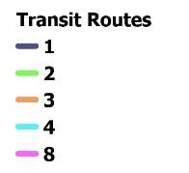
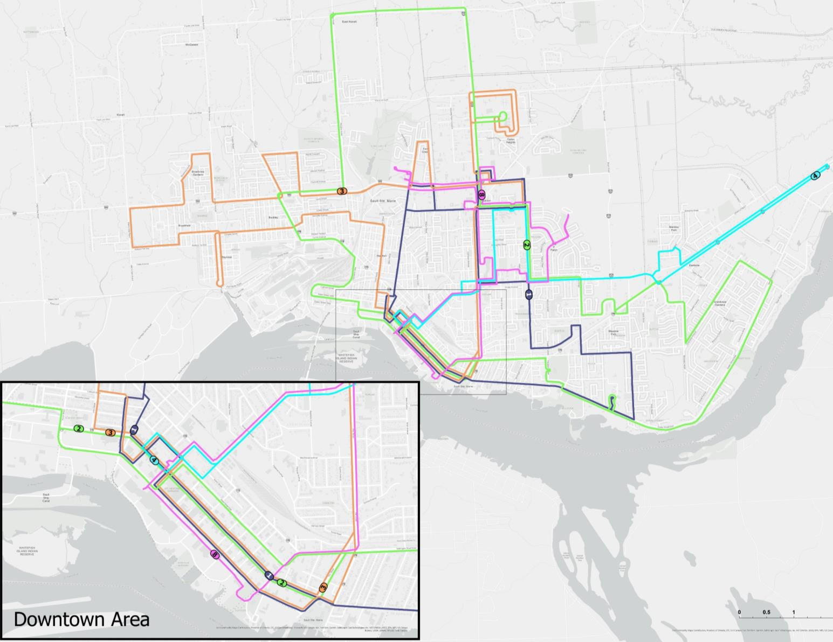
Option 2: Sault Loops
New loops 1, 2, and 3 operate in both directions and run every 30 minutes on weekdays. Loop 4 operates in one direction every 60 minutes.
Clockwise and counterclockwise departures. Half leave at :00 and :30 and half leave at :15 and :45
Improves frequency between popular destinations and reduces wait times and transfers.
Impact: Moderate reduction in coverage, but more direct, consistent service with buses connecting to major destinations every 15 minutes.

Slide 11


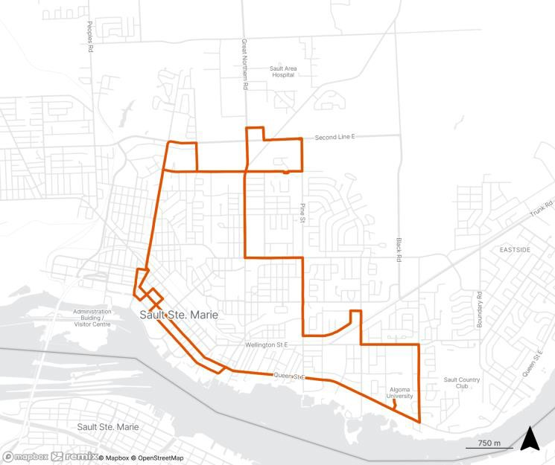
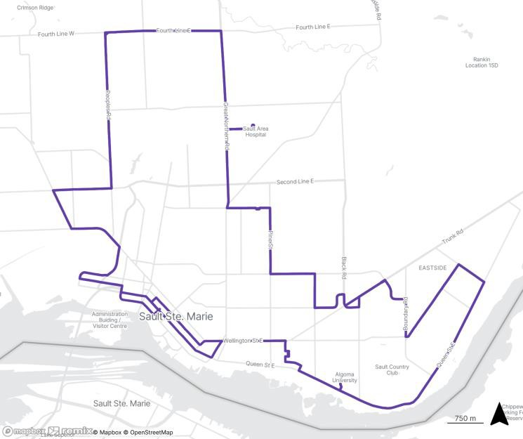
Proposed
Description
Operates in both directions
(CW, CCW)
Connecting downtown, Algoma University, Sault College, Walmart
30min headway during the
day on weekdays, 60min headway in the evening and on weekends
4 peak vehicles
Option 2 Route Realignment: Loop 1
Operates in both directions
(CW, CCW)
Connecting downtown, John Rodes Community Center Algoma University, Eastside, Hospital, Fourth Line, Second Line, and Korah Rd
30min headway during the day on weekdays, 60min headway in the evening and on weekends
6 peak vehicles
Option 1 Route Realignment: Loop 2

Slide 12
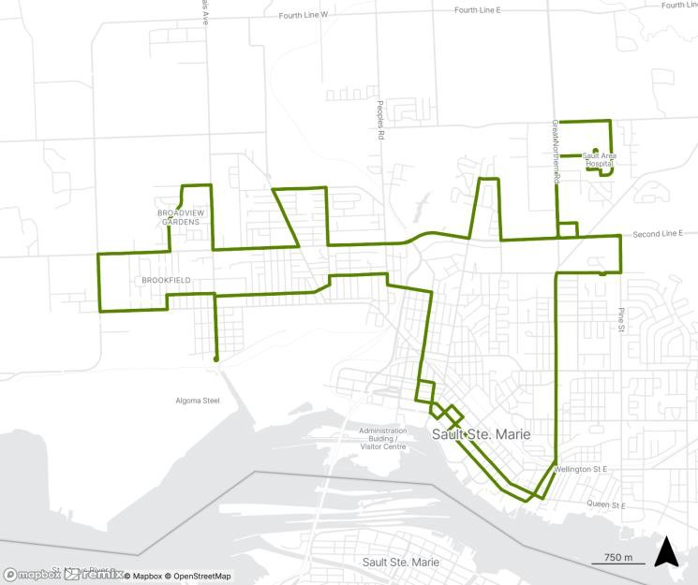
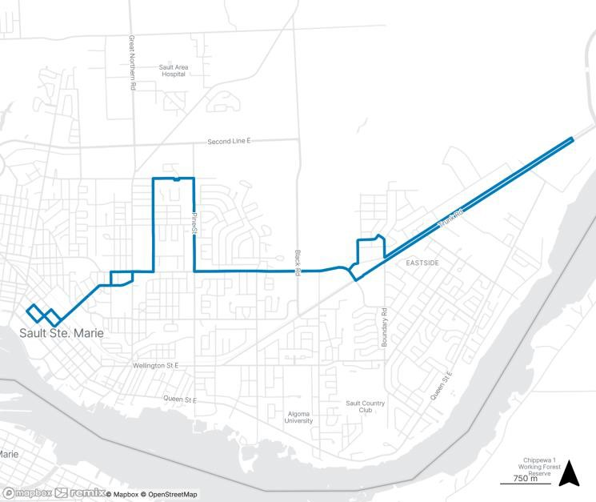
Proposed
Description
Operates in both directions
(CW, CCW)
Connecting downtown, Sault College, Hospital, Second Line, Algoma Steel
30min headway during the
day on weekdays, 60min headway in the evening and on weekends
6 peak vehicles
Option 2 Route Realignment: Loop 3
Operates as a single loop
Connecting downtown to Trunk/Frontenac via McNabb
60min headway during the
day on weekdays, 60min headway in the evening and on weekends
1 peak vehicle
Option 1 Route Realignment: Loop 4

Slide 13
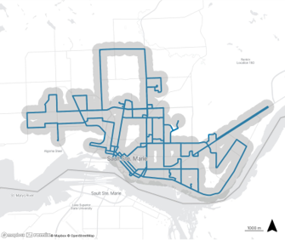
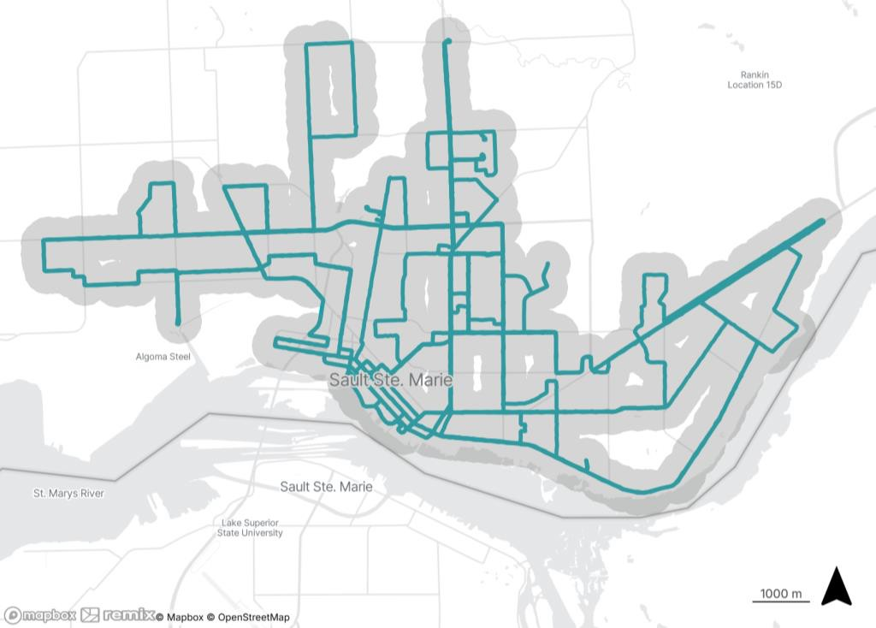
Option 2 Route Realignment
Population/Jobs within 400m (5 min walk) of bus stops
Existing
Proposed

Slide 14
What do you think about Option 2?
Write your ideas on sticky notes and place them
in one of the boxes below.
What do you like about Option 2?
What do you not like about Option 2?
Have we missed anything?

Slide 15
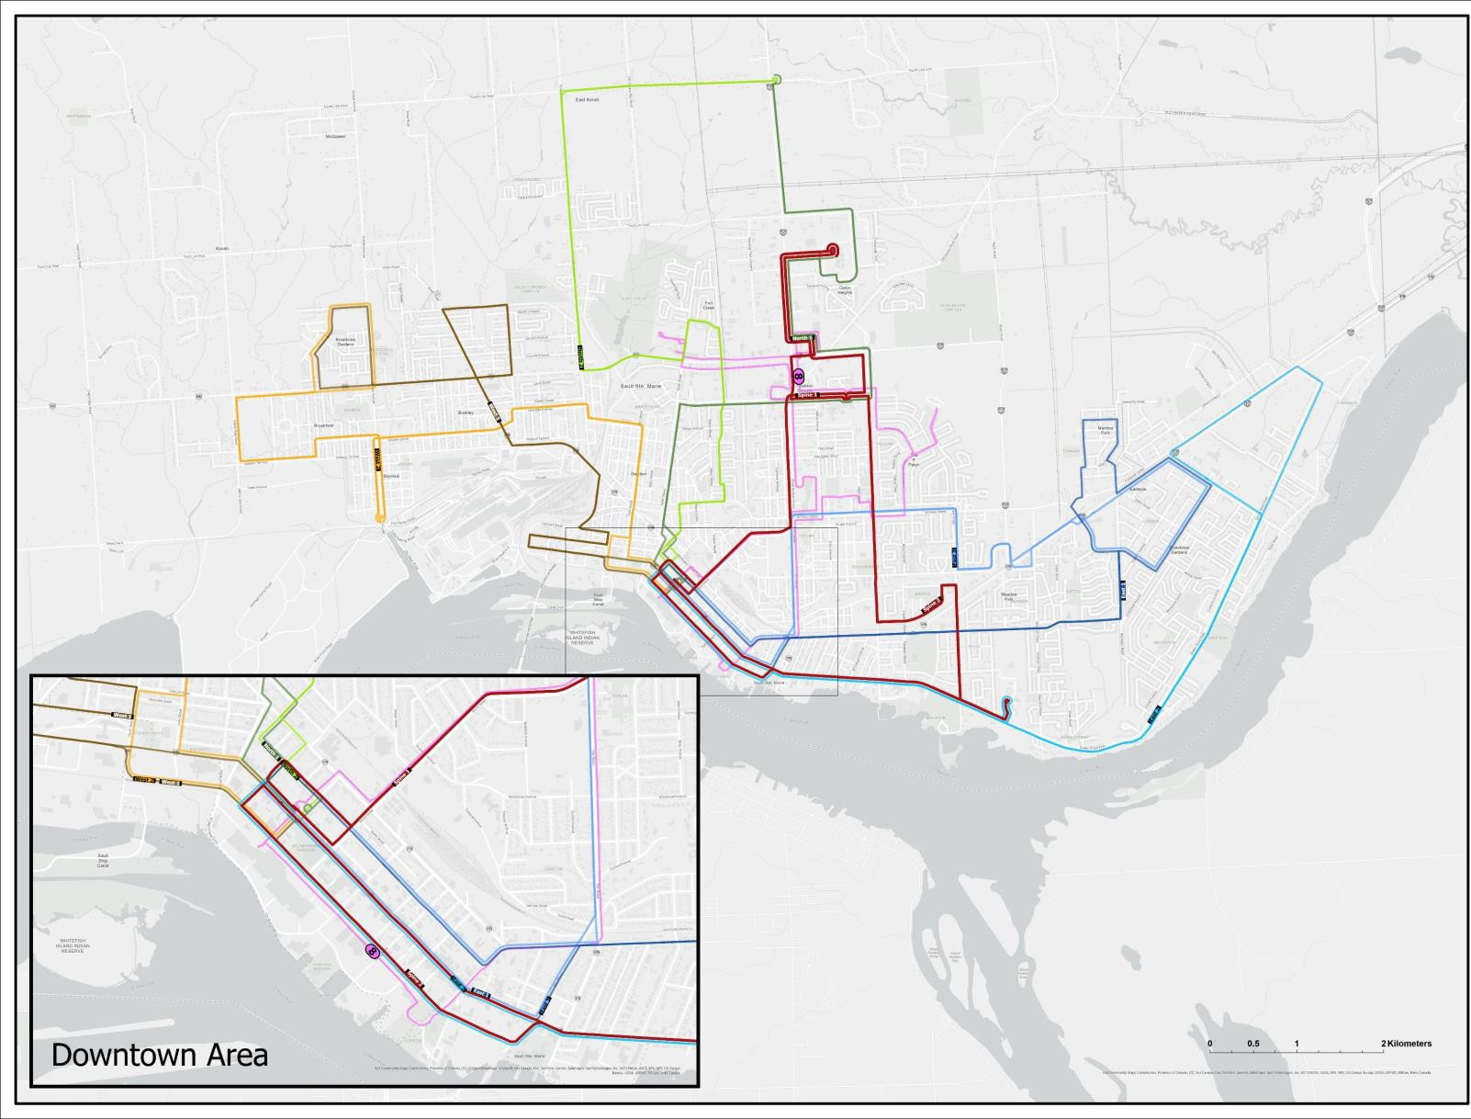
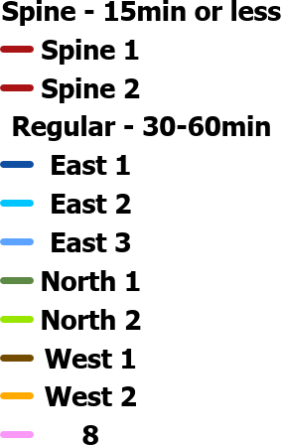
Option 3: Sault Spine
Introduces a high-frequency "spine" connecting core areas of Downtown,
Algoma University, Sault College, and the Hospital.
Buses on the spine run every 15 minutes in both directions.
Other routes feed into this core spine as well as the Downtown terminal,
Reducing the need for one-way loops.
Impact: Reduced area coverage, but major improvements in speed, connectivity, and frequency along key corridors. This option will require 5 additional buses than what the system currently has and will cost significantly more than the current expenditure.

Slide 16
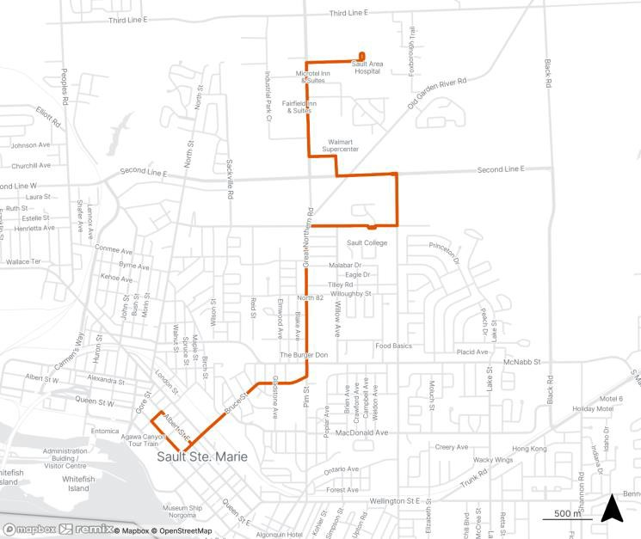
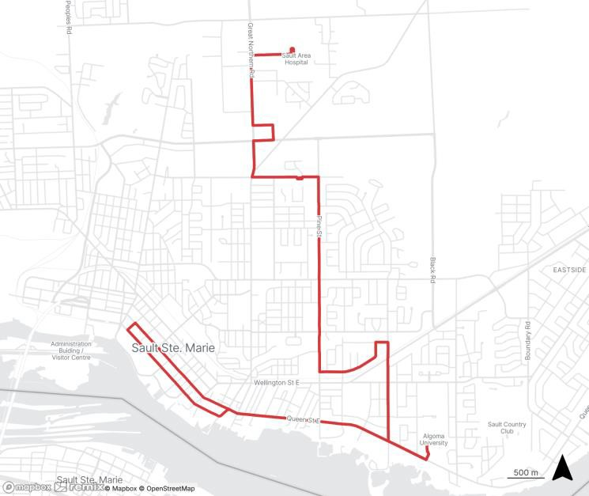
For more information, visit
saultstemarie.ca/transitstudy
Proposed
Description
Connecting downtown, Sault
College, Walmart, and Hospital
15min headway during the day on weekdays, 60min headway in the evening and on weekends
3 peak vehicles
Spine 1
Route:
Great Northern Rd
Connecting downtown, Algoma University, Sault College, Walmart, and Hospital
15min headway during the day
on weekdays, 60min headway in the evening and on weekends
5 peak vehicles
Spine 2 Route:
Algoma/Pine St
18

Slide 17

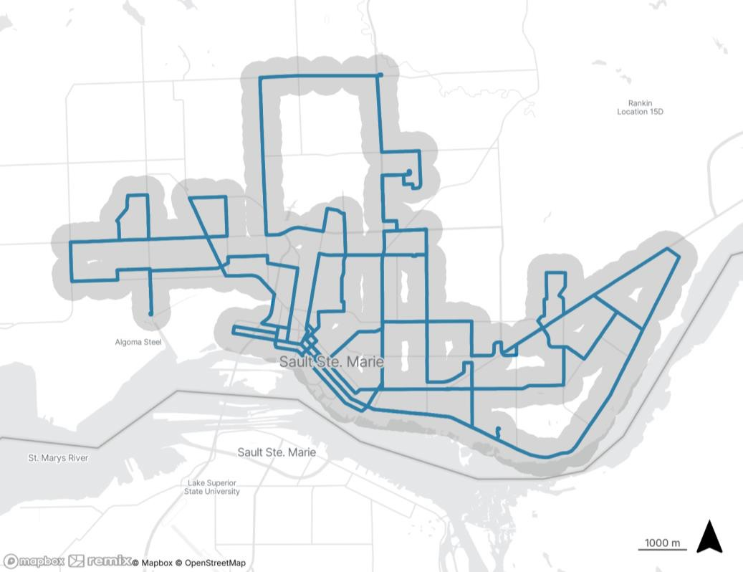
Option 3 Route Realignment
Population/Jobs within 400m (5 min walk) of bus stops
For more information, visit
saultstemarie.ca/transitstudy
Existing
Proposed
19

Slide 18

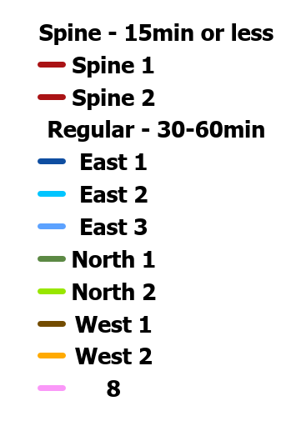
Option 3
What do you think about Option 3?
Write your ideas on sticky notes and
place them in one of the boxes below.
What do you like about Option 3?
What do you not like about Option 3?
Have we missed anything?
2
0

Slide 19
Reinstating Weekend-Evening Fixed-Route Service
Patching the 6 p.m. Service Gap
6pm Headway Gap (min)
Average Weekend On-Demand Riders
120
100
80
60
40
20
0
105
105
900
800
700
600
500
400
300
200
100
0
792
75 75 75 75
75
758
Headway
547
196
208
1 2 3 4 5 6 7
Route
2020
2021
2022
2023
2024
A significant service gap exists at 6 p.m. as service transitions from 30-minute daytime to 60-minute evening schedules
Gaps in service are most significant on Routes 5 and 7
Demand for weekend evening service has grown 280% since on-demand was introduced in 2020
With a trip refusal rate of 33% (up from 9% in 2020), weekend evening on-demand service can no longer effectively serve the needs of the travelling public
Total buses and drivers required for on-demand service on weekend evenings are the same as what is required for fixed-route services during weekday evenings
21

Slide 20
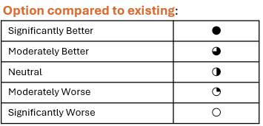
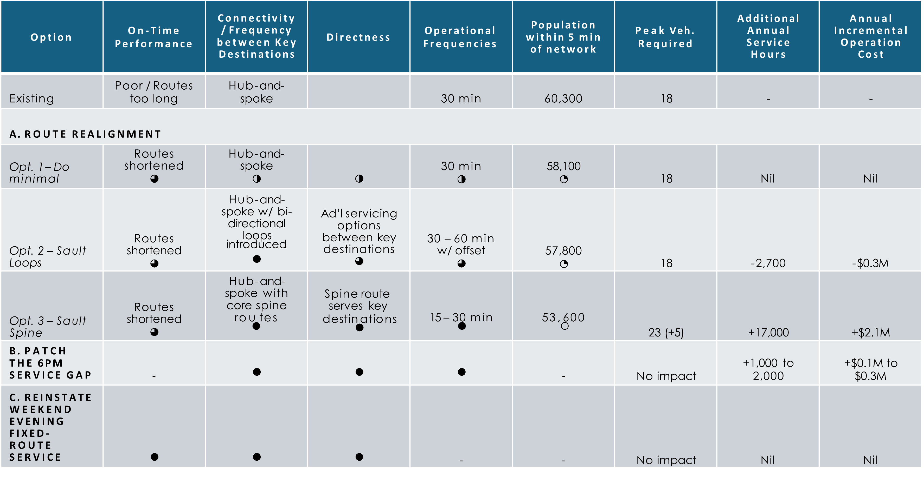
Option Summary
2
2

Slide 21
Preferred Route Option
Using the sticky notes tell us which route you like best
Option #1
Option #2
Option #3

Slide 22
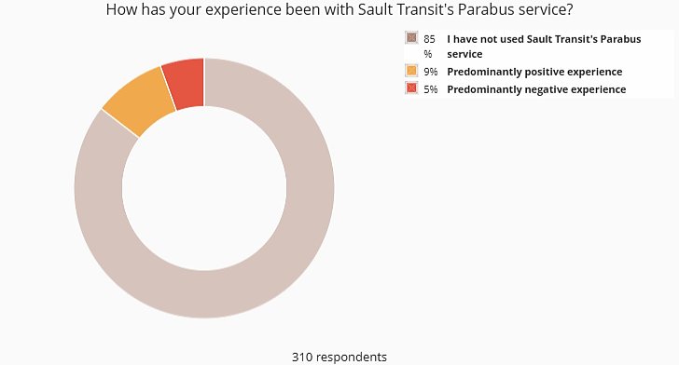
Parabus Service
What we heard:​
While only 15% of respondents used Parabus services, most users had a predominantly positive experience​
Issues included:​
Trips get booked up very quickly; 2-week notice for booking is restrictive​
Broad timing windows for pick-up/drop-off make it hard for passengers to plan their day and appointments
No prioritization for urgent trips
Parabus servicing considerations will be addressed in the following phase of this study

Slide 23
Relocating the Transit Centre
Opportunities include:
Enhanced security to include lighting and video monitoring system
Streamlined operations by having staff and mechanics on site
Realized cost savings
Increased seating area
Fully accessible washrooms
New kiosk and public information area
Accessible sidewalks and exterior canopy
Common relocation concerns:
Reduced convenience to Downtown shops, services, social services, jobs, GFL Gardens, and Station Mall
Impact on service reliability
Traveler safety at a more isolated location
Lack of nearby amenities while waiting for a bus
24

Slide 24
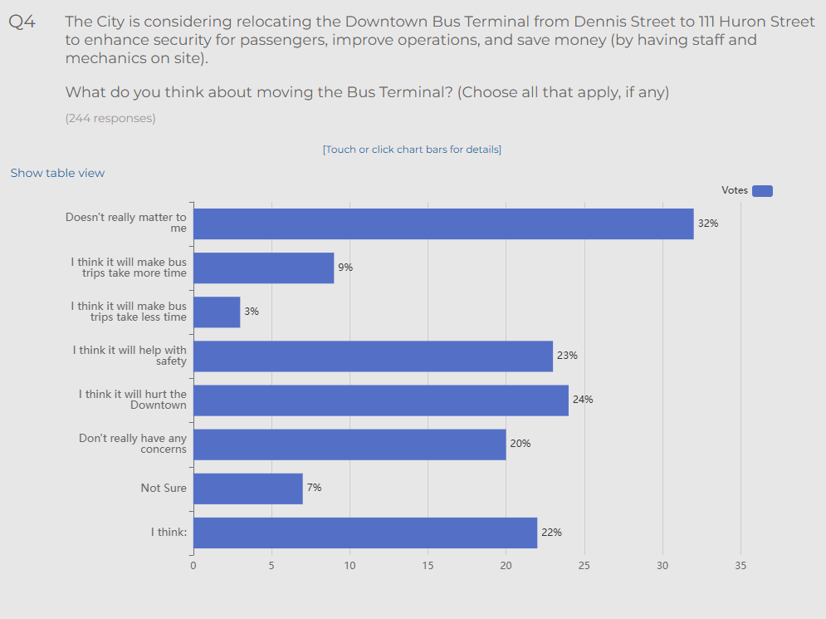
Relocating the Transit Centre
24

Slide 25
Relocating the Transit Centre
Considerations around the potential transit terminal relocations will be identified in the following phase of this study.
24

Slide 26
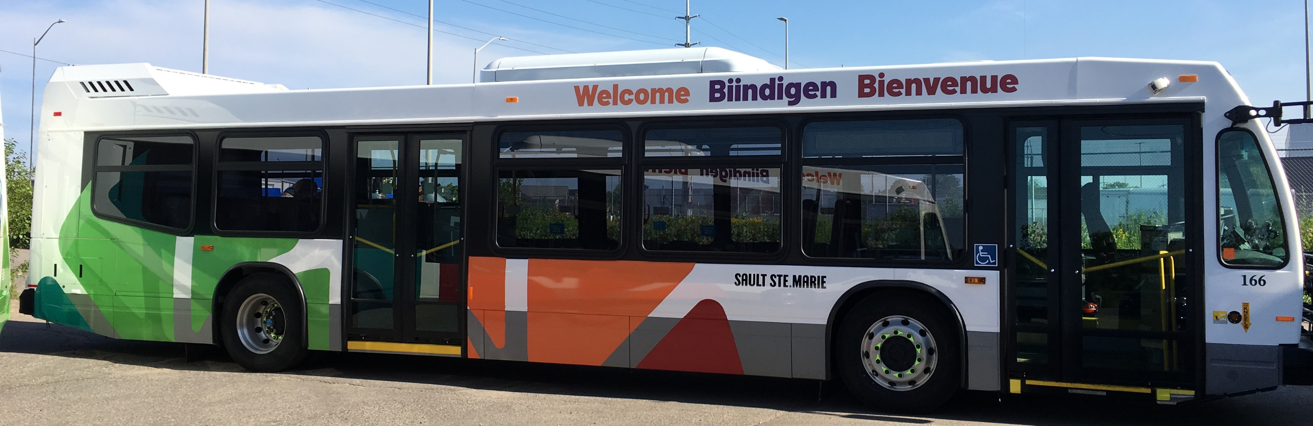

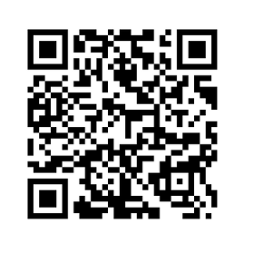
For more information, visit
saultstemarie.ca/transitstudy
Next Steps:
Feedback received on the service options will be reviewed and considered in selecting a preliminary preferred network service strategy.
For more information on the Transit Optimization Study or to share your feedback, visit saultstemarie.ca/transitstudy

