Slide 1



Comprehensive Review of the Conventional Transit Operation
Drop-in Information Session
Wednesday, June 25, 2025

Slide 2
Project Overview:
Study Timeline
July 2025 –
August 2025
June 2025 –
July 2025
April 2025 –
July 2025
WE ARE
HERE!
December 2024 –
April 2025
Phase 4:
Evaluate fleet, staffing, costs, and fare structure; recommend tech for ridership, assess specialized transit, and recommend policy and service improvements.
Phase 5:
Draft a Five-Year Transit Optimization Plan and a Ten-Year High Level Transit Management Plan.
November 2024 –
December 2024
Phase 3:
Update transit standards, explore Downtown terminal relocation, recommend route designs consider service area expansion.
Engagement with the public through Public Information Centre #2
Phase 2:
Review of policy, demographics, transit operations, LOS, benchmarking, barriers, and engagement of stakeholders and the public through surveys and Public Information Centre #1
Phase 1:
Project initiation & Data
Collection.

Slide 3

Summary of Existing Conditions
Sault Ste. Marie Transit routes are designed to maximize coverage and converge at the Dennis Street terminal
Routes can be circuitous, resulting in indirect travel outside of the core
On-time performance issues are noted on several routes
30-minute systemwide daytime service (60-minute evening and weekend service) everywhere, regardless of demand
Service gap noted at 6 p.m. with switch to evening schedule; weekend evening on-demand service is misaligned with customer needs

Slide 4
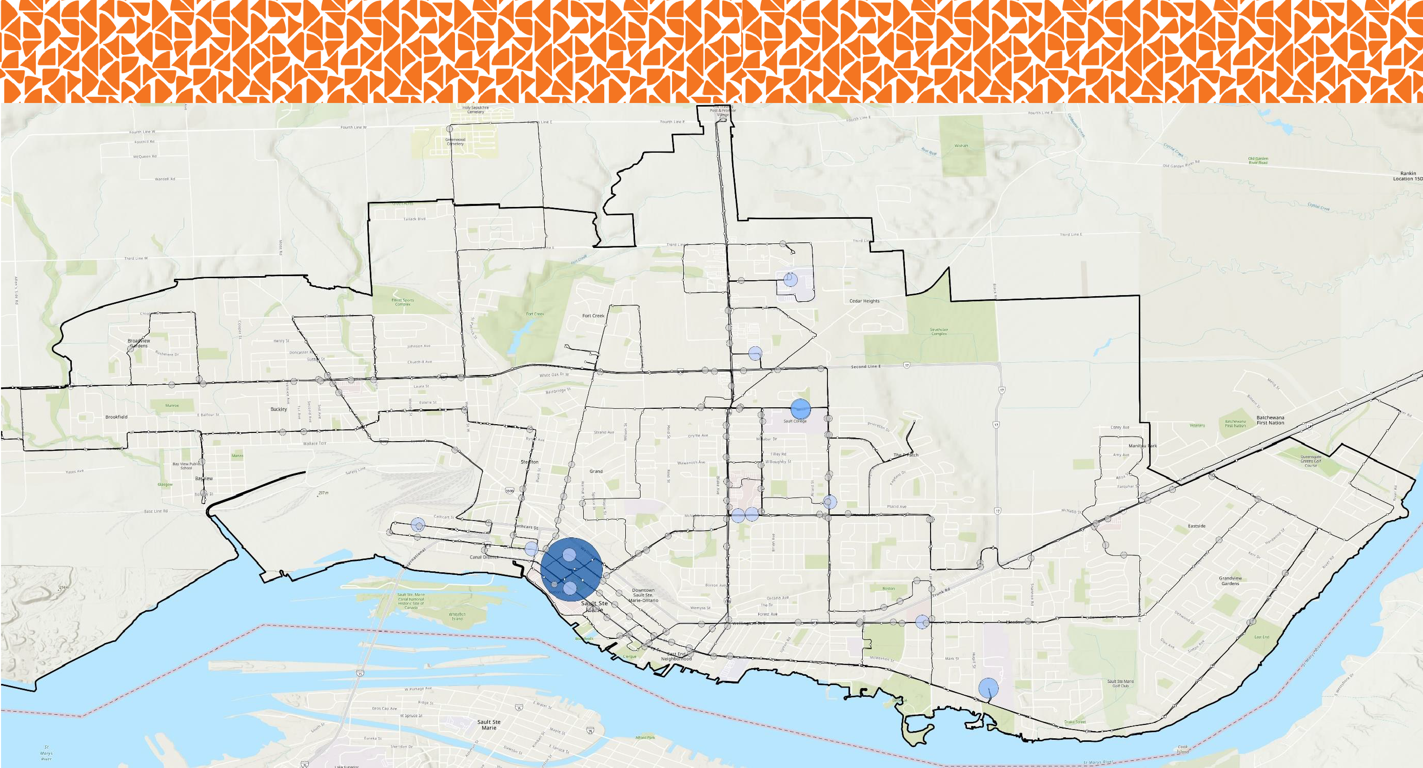

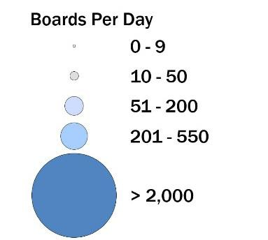

Average Weekday Boardings
2500.0
2000.0
1500.0
1000.0
500.0
0.0
2,074
542
506
239
110 110
98
78
61
58
57
TERMINAL
ALGOMA UNIVERSITY
NORTHERN TRANSFER HUB
NORTHERN TRANSFER HUB
FOOD BASICS PINE STREET
WALMART
STATION MALL
ALBERT STREET WEST @ JAMES STREET
WELLINGTON STREET EAST @ LAKE STREET
36 QUEEN STREET WEST
Group Health
Centre McNabb
2,150 Boards
(26%)
630 Boards (8%)
TOTAL: 8,240 Daily Weekday Boardings
3,470 Boards (42%)
480 Boards (6%)
1,190 Boards (14%)
4

Slide 5
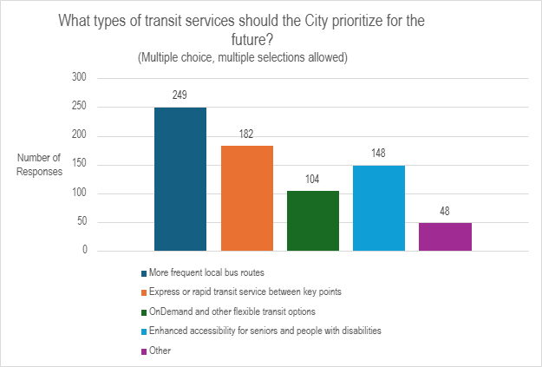
What We Heard:
Rider and Community Survey

Slide 6
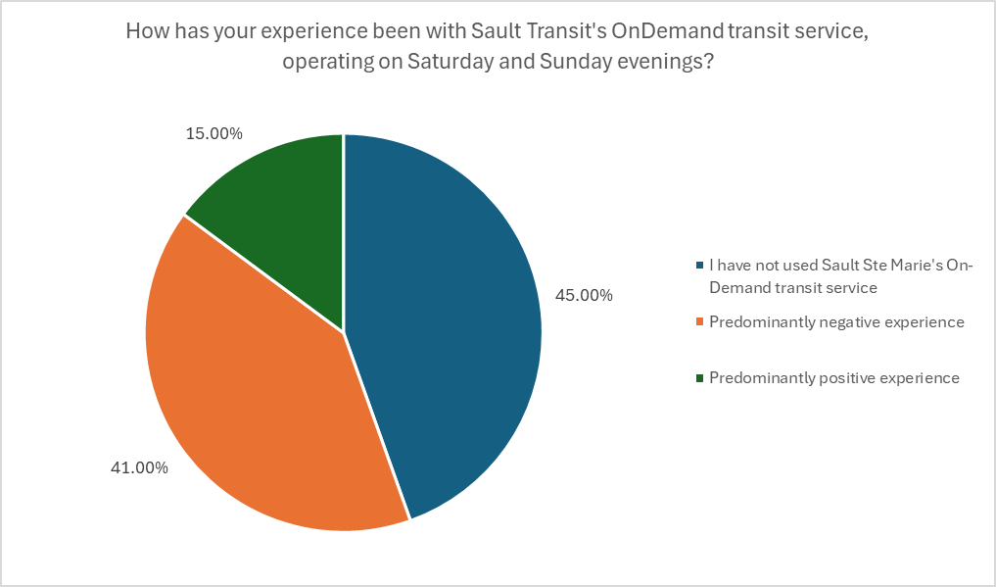
What We Heard:
Rider and Community Survey

Slide 7
What We Heard:
Public Information Centre #1
PIC #1 held at City Hall on March 25, 2025
General feedback:
  Transit should not only be a means for point-to-point transportation but should support an equitable, affordable, and sustainable community.
  The City should provide easy, accessible, and affordable public transit that allows for citizens to choose to take transit and rely less on private vehicles.
Key Priorities:
Improve frequency and reliability
Improve route directness
Improve paratransit and alter OnDemand transit
Expand periods of operations

Slide 8
Draft Transit System Vision and Guiding Principles
DRAFT Vision Statement
Sault Transit will retain its share of the travel market by providing a local public transportation system that is supported by residents, academic institutions and the business community.
Guiding Principles
Provide relatively direct service between primary origins and
destinations
Provide reliable, predictable, on-time, and easy-to-comprehend
all-day service for the community
Provide vital connectivity and improve the quality of life of residents who do not have access to an automobile.
Provide a safe, dignified, fully-accessible service with barrier-free
access to bus stops
Meet the travel demand generated by various target markets in the employment, academic, commercial, medical, and service industries.
Service Objectives
Service Area Objective: Sault Transit should provide service within the urbanized area of Sault Ste. Marie.
Periods of Operation Objective: The minimum frequency of service and service hours to be provided shall be adequate to meet the various target markets within the community, including work shifts that begin at 7:00 a.m. and end at 11:00 p.m.
Connectivity Objective: Key destinations should be
interconnected with relatively direct and frequent service. Key destinations should be connected, if possible through multiple paths to expand rider choice.

Slide 9

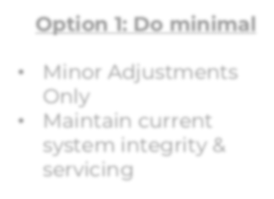
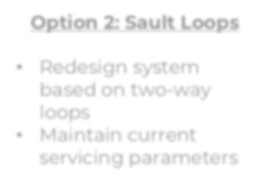
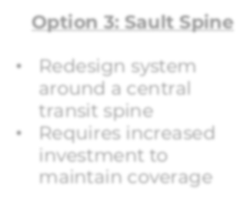
Potential Big Moves
A. ROUTE REALIGNMENT
Route Redesign:
Small Modifications:
Option 1:
Do minimal
Option 2:
Sault Loops
Option 3:
Sault Spine
Redesign system around a central transit spine
Requires increased investment to maintain coverage
Minor Adjustments only
Maintain current system integrity & servicing
Redesign system based on two-way loops
Maintain current servicing parameters
B. PATCH THE 6 PM SERVICE GAP
C. ELIMINATE WEEKEND EVENING ON-DEMAND SERVICE

Slide 10
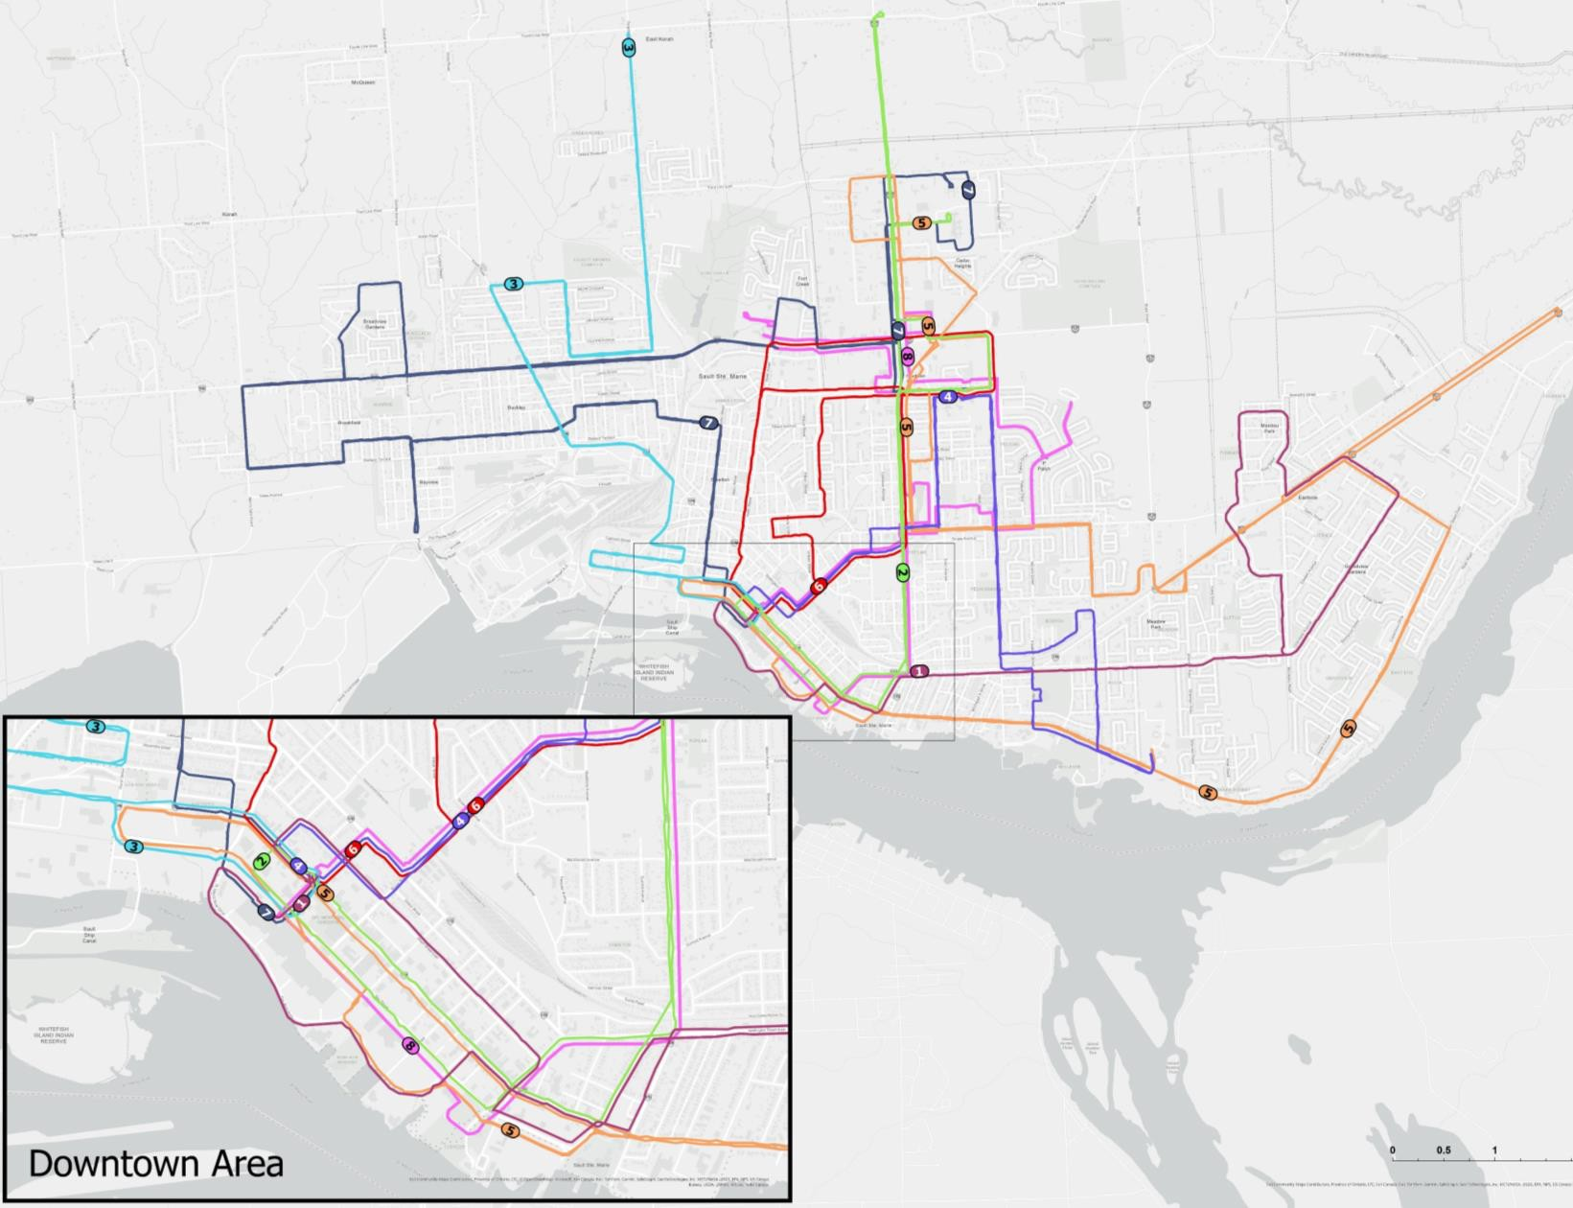
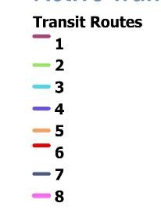
Option 1: Minimal Changes
Streamline existing routes by
removing underused segments.
Shorten long routes to improve on- time performance.
Minor adjustments to Routes 3, 5,
and 7.
Impact: Slight reduction in coverage, but small improvements in reliability and efficiency.
10

Slide 11


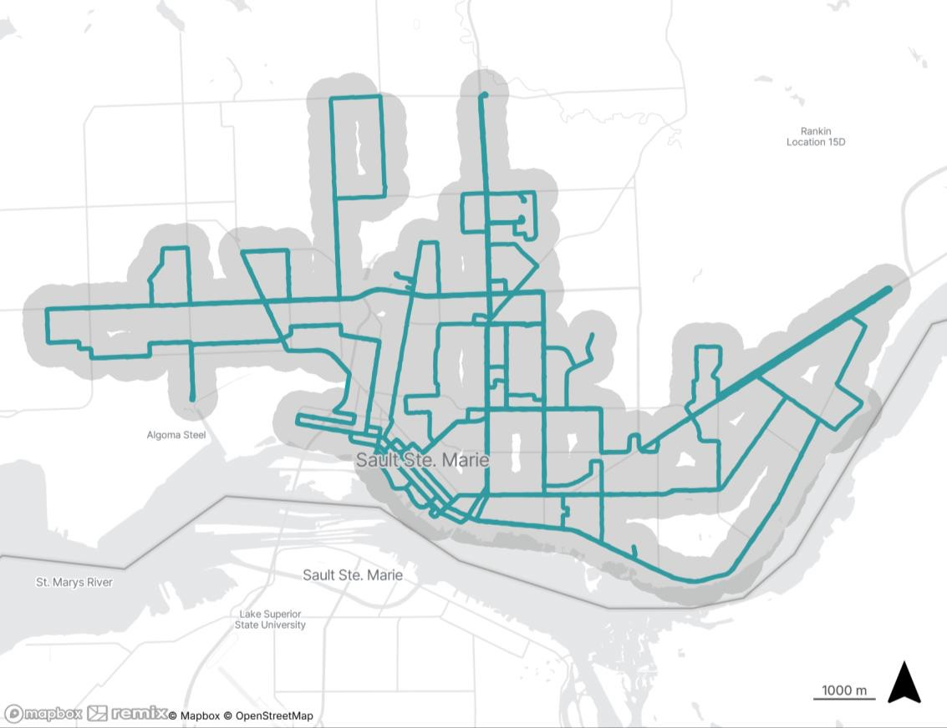
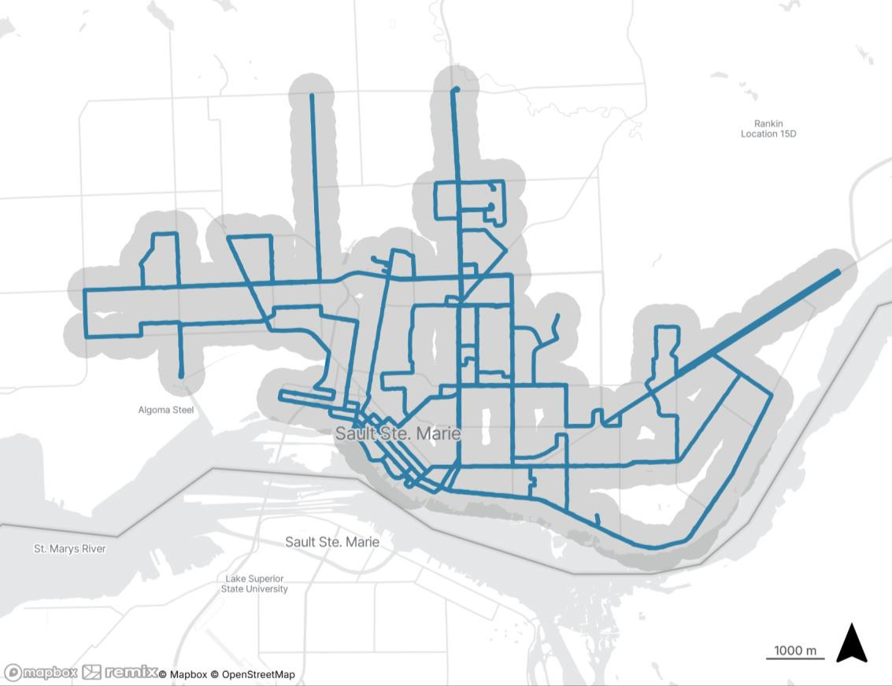

Option 1 Route Realignment
Population/Jobs within 400m (5 min walk) of bus stops
Existing
Proposed
11

Slide 12
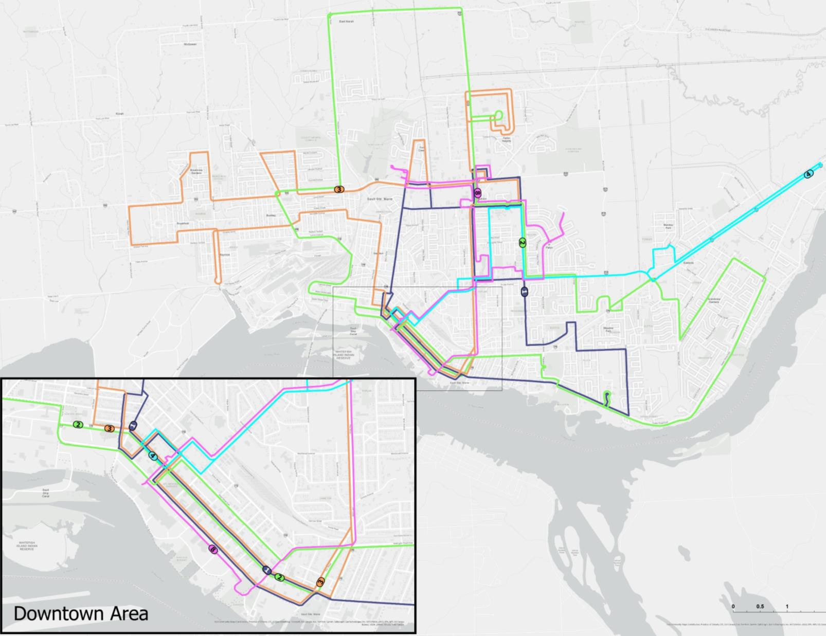

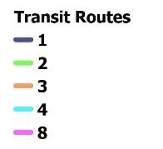
Option 2: Sault Loops
Redesign nearly all routes (except Route 8 Community Bus, which stays the same)
New Loops 1, 2, and 3 operate in both directions and run every 30 minutes on weekdays, Loop 4 operates in one direction every 60 minutes
Uses an “offset schedule” (clockwise and counterclockwise departures): half the buses leave downtown at :00 and :30; the other half at :15 and :45
Improves frequency between popular destinations and reduces wait times and transfers
Impact: Moderate reduction in coverage, but more direct, consistent service with buses connecting major destinations every 15 minutes
12

Slide 13


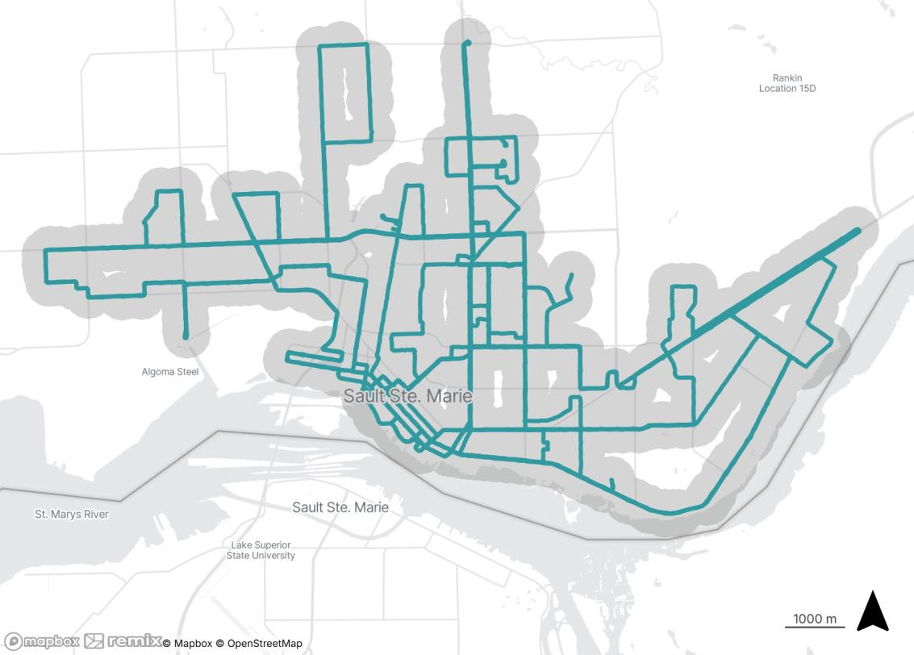
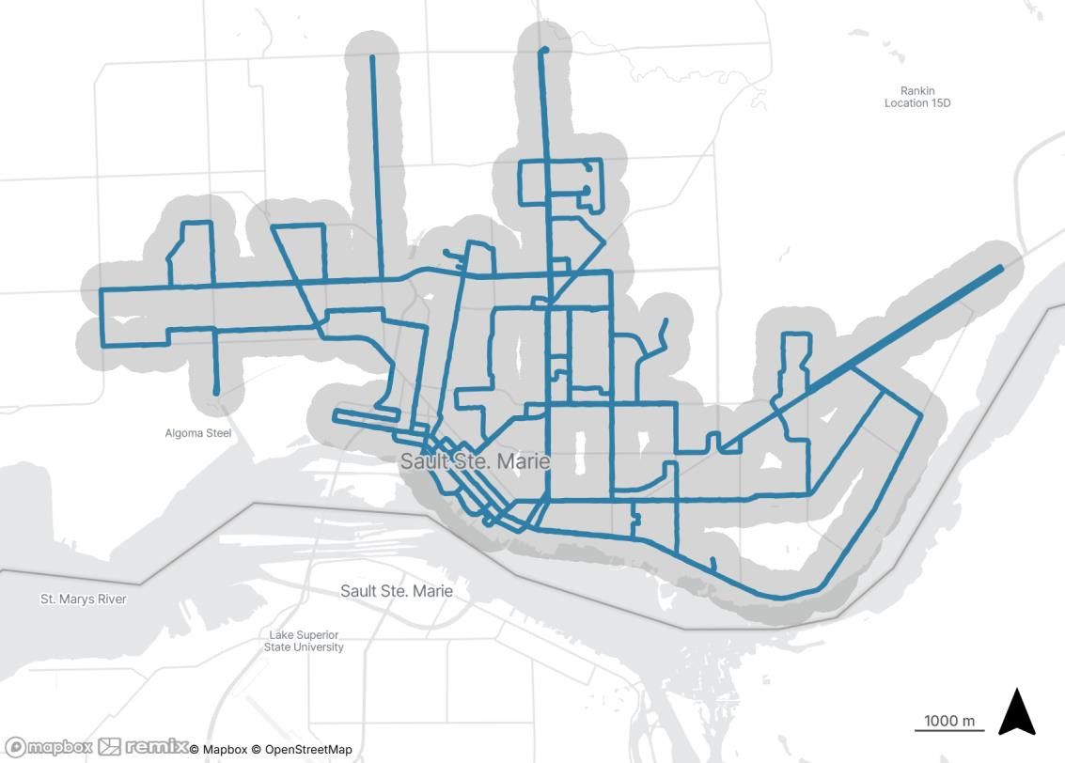
Option 2 Route Realignment
Existing
Proposed

Slide 14

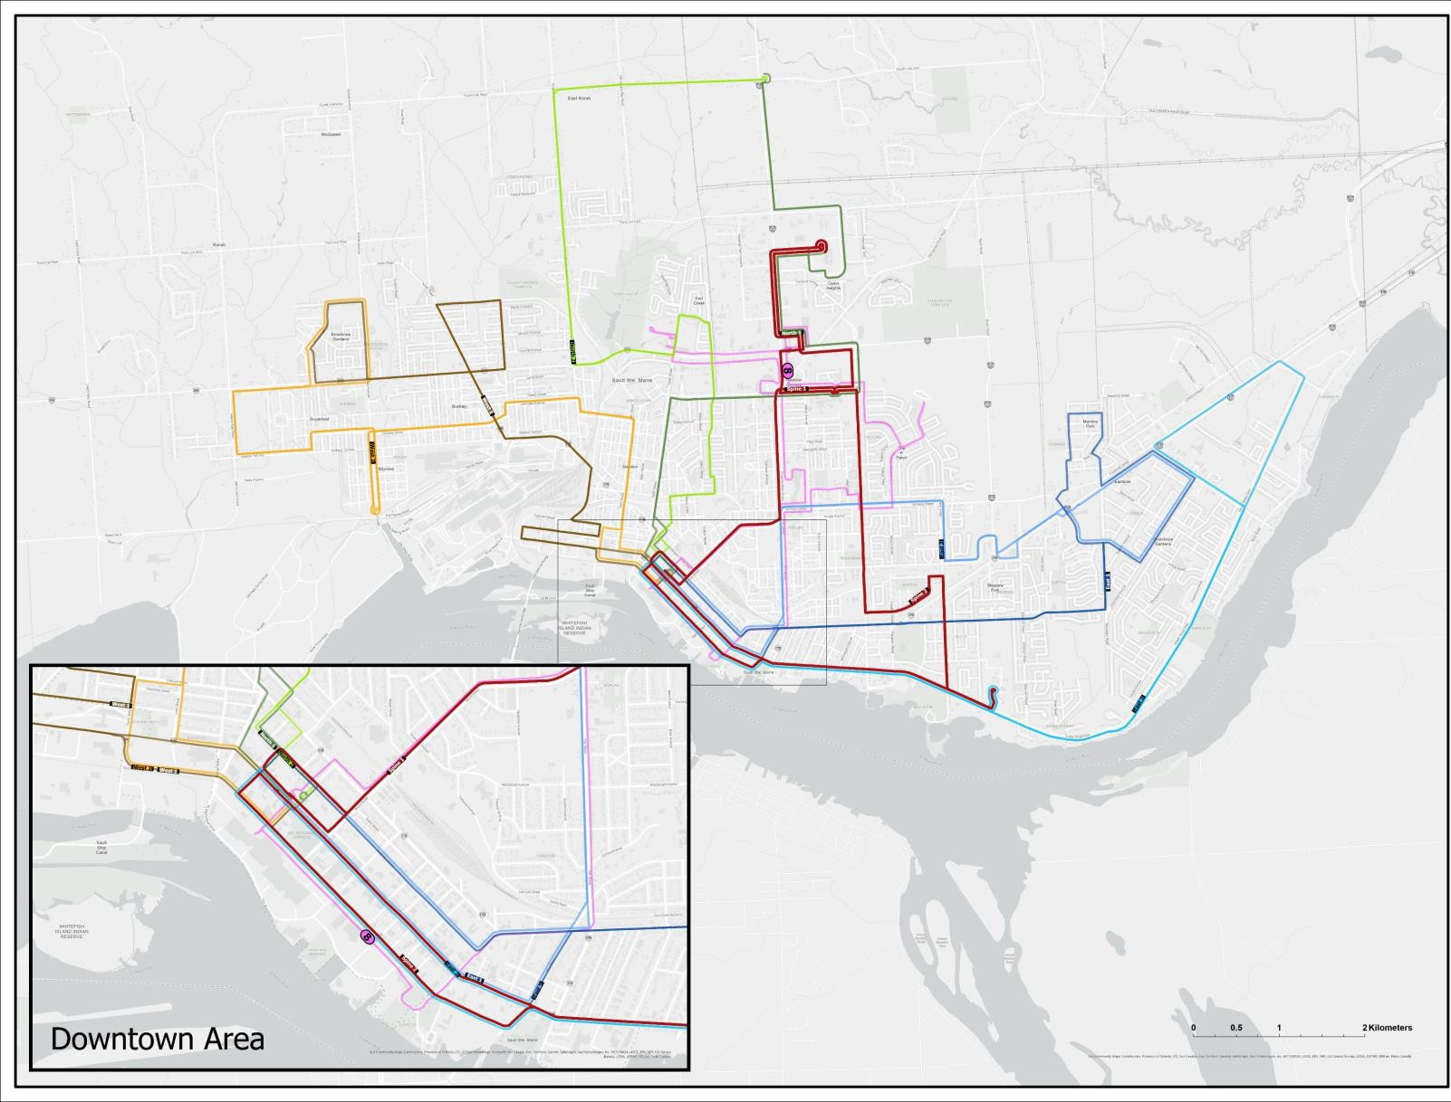
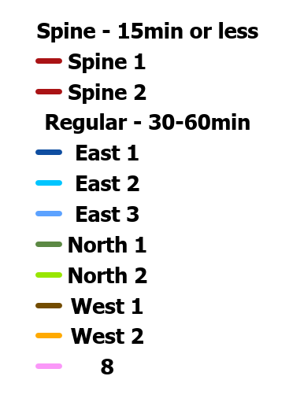
Option 3: Sault Spine
Introduces a high-frequency “spine” connecting core areas of Downtown, Algoma University, Sault College, and the Hospital.
Buses on the spine run every 15
minutes in both directions.
Other routes feed into this core spine as well as the Downtown terminal, reducing the need for one-way loops.
Impact: Reduced area coverage, but major improvements in speed, connectivity, and service frequency along key corridors.

Slide 15
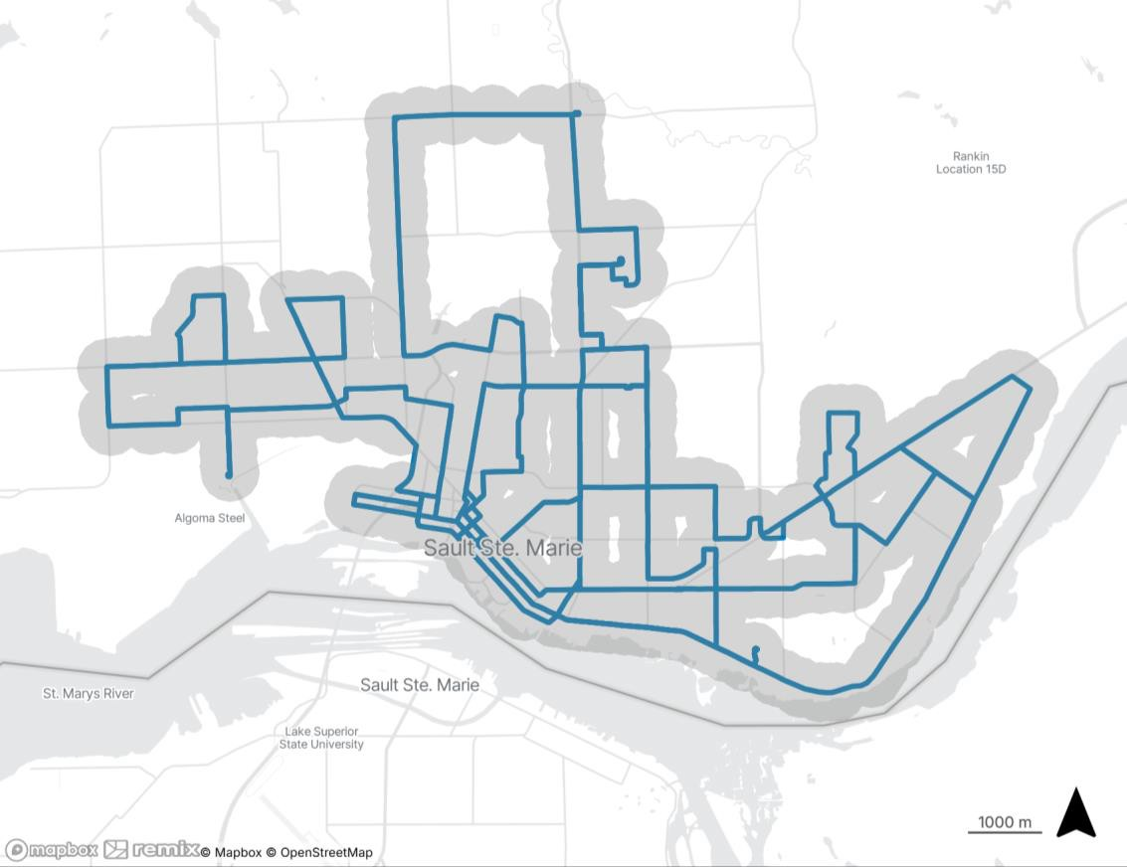
Option 3 Route Realignment
Existing
Proposed

Slide 16
Patching the 6 PM Service Gap
6pm Headway Gap (min)
120
A significant service gap exists at 6pm as service transitions from 30-minute daytime to 60-minute evening schedules
Gaps in service are most significant on Routes 5 and 7
105
105
100
80
75 75 75 75
75
Headway
60
40
20
0
1
2
3
4
Route
5
6
7

Slide 17
Reinstating Weekend-Evening Fixed-Route Service
Average Weekend On-Demand
Demand for weekend evening service has grown 280% since on-demand was introduced in 2020
With a trip refusal rate of 33% (up from 9% in 2020), weekend evening on-demand service can no longer effectively serve the needs of the travelling public
Total buses and drivers required for on- demand service on weekend evenings are the same as what is required for fixed-route services during weekday evenings
Riders
900
800
700
600
500
400
300
200
100
0
792
758
547
196
208
2020 2021 2022 2023 2024

Slide 18
Option compared to existing:
 |  |  |  |  |  |  | Significantly Better |  |  | ●
 |  |  |  |  |  |  | Moderately Better |  |  | ◕
 |  |  |  |  |  |  | Neutral |  |  | ◑
 |  |  |  |  |  |  | Moderately Worse |  |  | ◔
 |  |  |  |  |  |  | Significantly Worse |  |  | ○
Option | On-Time Performance | Connectivity / Frequency between Key Destinations | Directness | Operational Frequencies | Population within 5 min of network | Peak Veh. Required |  | Additional Annual Service Hours | Annual Incremental Operation Cost
Existing | Poor / Routes too long | Hub-and-spoke |  | 30 min | 60,300 | 18 |  | - | -
A. ROUTE REALIGNMENT
Opt. 1 – Do minimal | Routes shortened ◕ | Hub-and-spoke ◑ | ◑ | 30 min ◑ | 58,100 ◔ | 18 |  | Nil | Nil
Opt. 2 – Sault Loops | Routes shortened ◕ | Hub-and-spoke w/ bi-directional loops introduced ● | Ad’l servicing options between key destinations ◕ | 30 – 60 min w/ offset ◕ | 57,800 ◔ | 18 |  | -2,700 | -$0.3M
Opt. 3 – Sault Spine | Routes shortened ◕ | Hub-and-spoke with core spine routes ● | Spine route serves key destinations ● | 15 – 30 min ● | 53,600 ○ | 23 (+5) |  | +17,000 | +$2.1M
B. PATCH THE 6PM SERVICE GAP | - | ● | ● | ● | - | No impact |  | +1,000 to 2,000 | +$0.1M to $0.3M
C. REINSTATE WEEKEND EVENING FIXED- ROUTE SERVICE | ● | ● | ● | - | - | No impact |  | Nil | Nil
Option Summary

